Slide 1
Uninsured and Infected
Christopher Jossart
EDS 611
16 December 2019

Slide 2
Guiding Question
What is the relationship between insurance coverage and infectious disease mortality?
How does this relate to location?

Slide 3
Methodology
Acquire Data → Data sources IHME and SAHIE
Clean up Data → Tidyr, dplyr, base r
Explore Data → Ggplot, base r
Data Analysis → base r, biscale
Map Data → ggplot, socviz
*no specific order

Slide 4
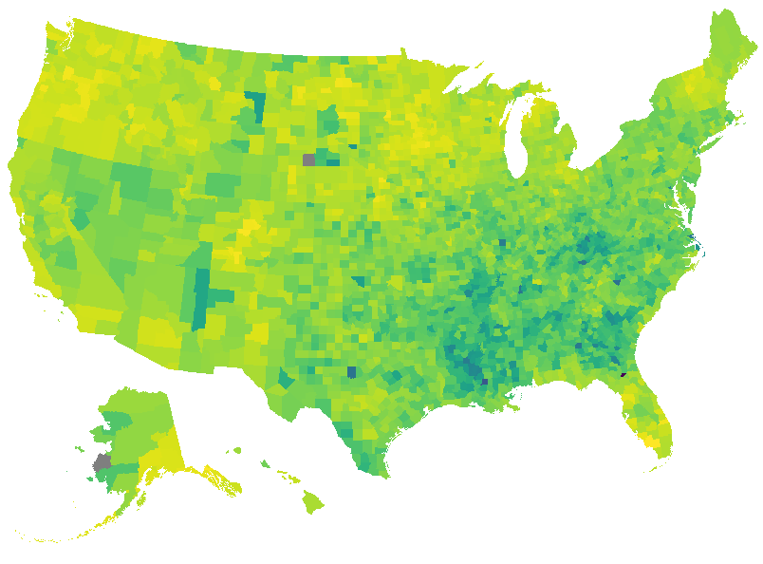

Infectious Disease Mortality Rate in 2010 and 2014
Notes:
2010: MIN = 12.76, MEDIAN = 33.20 MEAN = 34.58 MAX = 128.81
Probably could have removed outliers and these values and maps may look different
2012: MIN = 11.24 MEDIAN = 33.26 MEAN = 34.71 MAX = 132.64

Slide 5
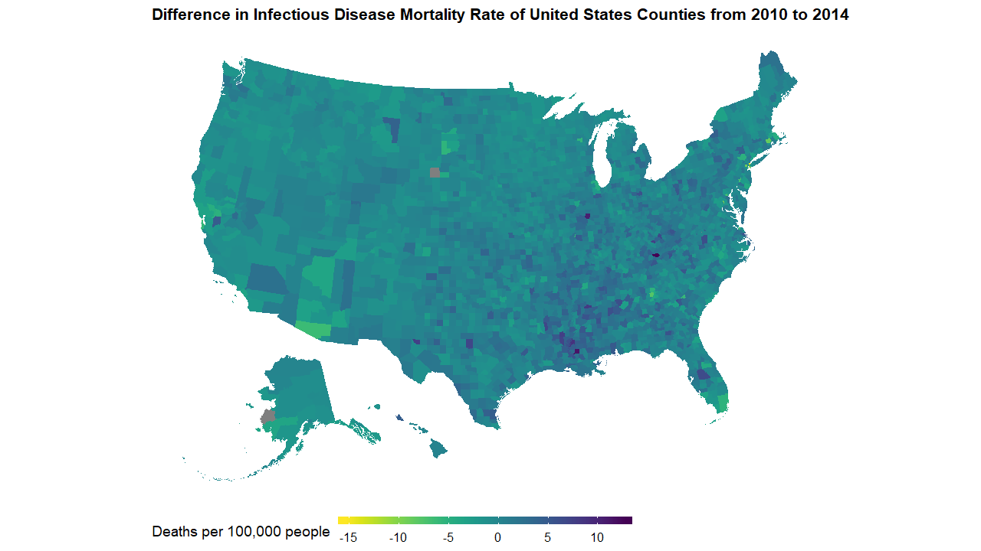
Notes:
MIN = -15.4500 MEDIAN = -0.0400 MEAN = 0.1297 MAX = 12.7100

Slide 6
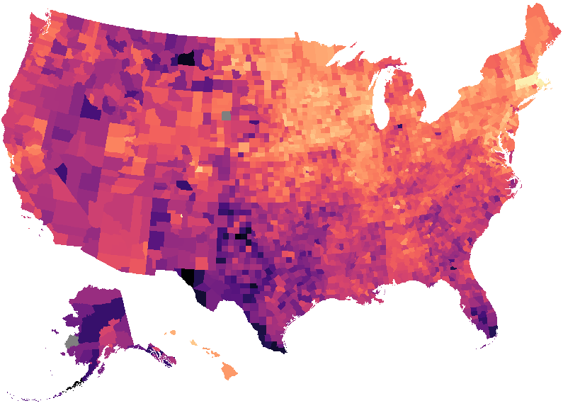
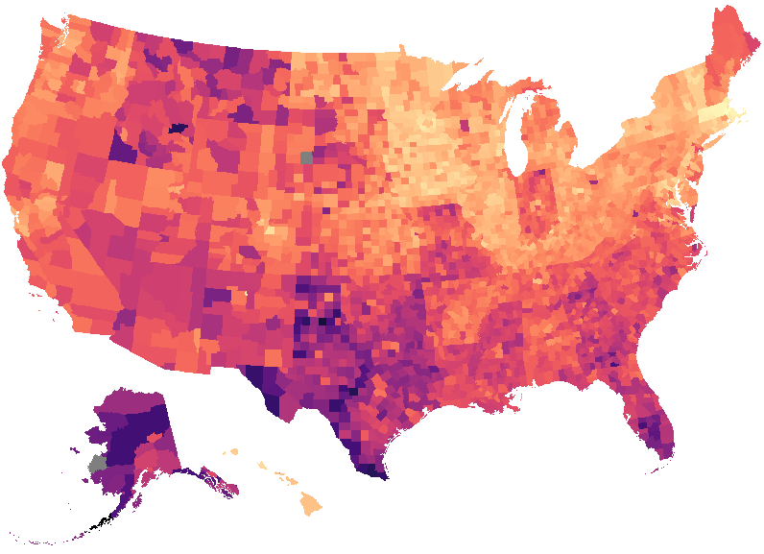
Percentage of uninsured in 2010 and 2014
Notes:
3.60 14.40 18.20 18.53 22.00 41.40
2.70 10.50 14.00 14.41 17.70 39.30

Slide 7
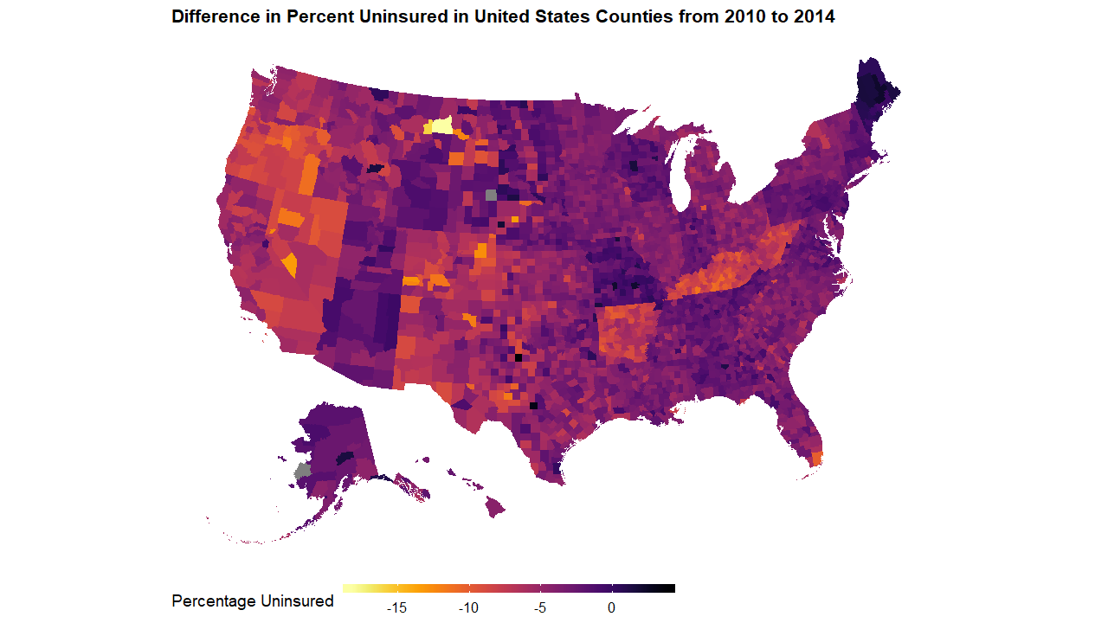
Notes:
-18.300 -5.200 -3.800 -4.122 -2.600 3.800

Slide 8
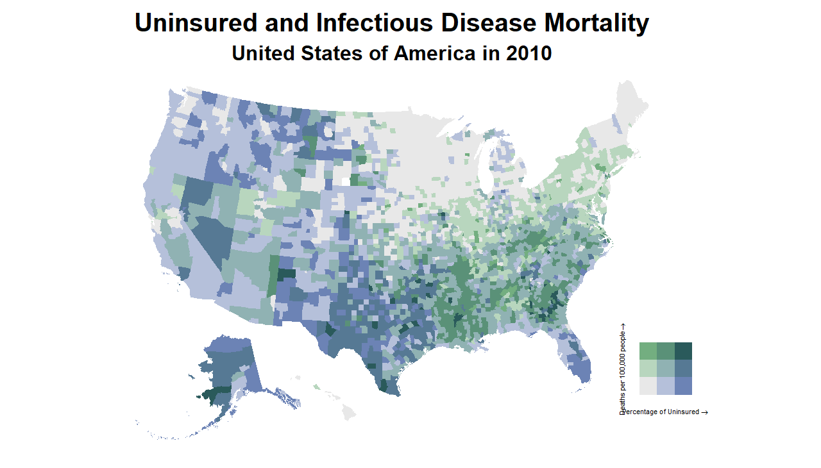

Slide 9
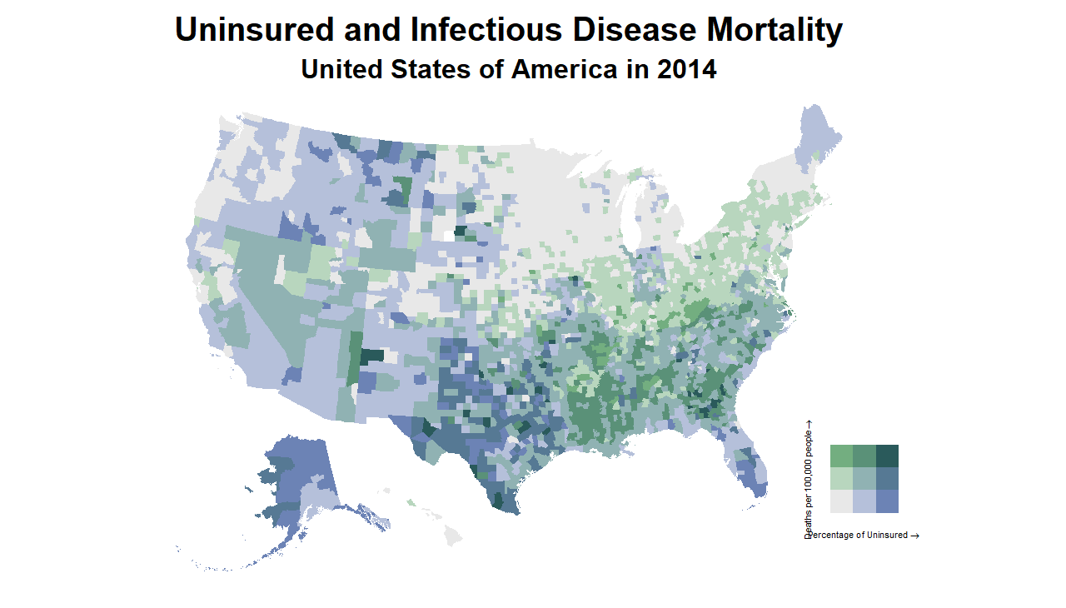

Slide 10
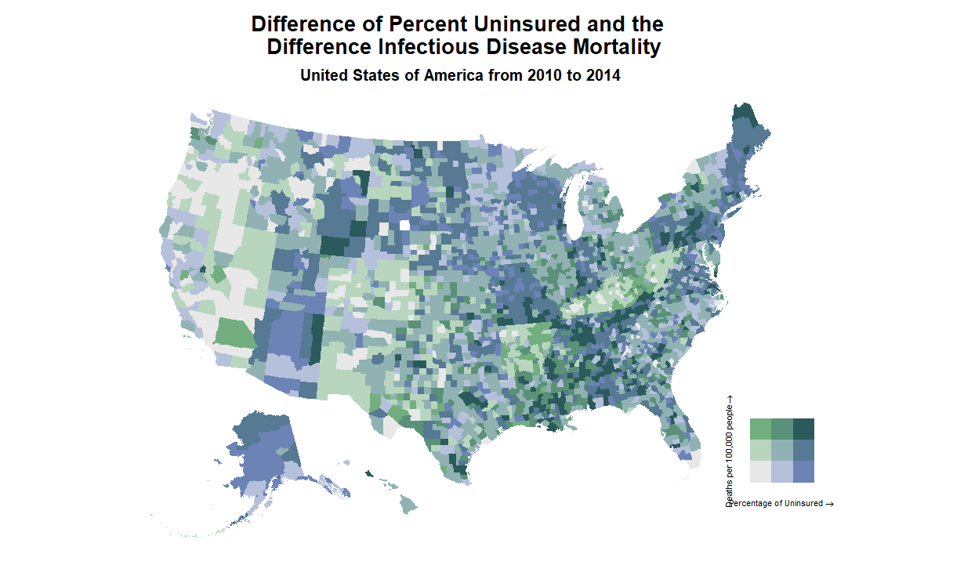

Slide 11
Discussion
This ecological study illustrates trends of uninsured and infectious disease mortality
State and region-specific trends, policy changes
Percent of uninsured and infectious disease mortality rate are not associated with each other based off bivariate analysis
But possibly related through other variables
Further questions and analyses
What other variables may be related/connected
Stratify by state, region, and demographics

Slide 12
Thank you and Questions

